Slide 1
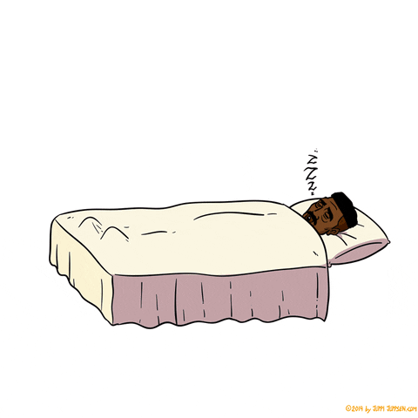
Work-Life Balance
How Not to Become a Zombie by Friday
Notes:
Good afternoon everyone!
Today, we're going to talk about something we all struggle with—balancing work (or studies) and personal life. Whether you're a student with too many assignments or someone working long hours, it's easy to feel overwhelmed.
In this presentation, we'll:
- Explain what work-life balance really means.
- Discuss why it's so hard to achieve.
- Share simple, practical tips to help you find more time for yourself.
- Look at real examples (including my own struggles!).
By the end, you’ll have some easy ideas to reduce stress and enjoy life more.
Sound good? Let’s get started!

Slide 2
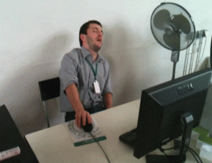
Balance = when you’re not like this guy on Friday ➡️
Ideal day: 8 hours of work, 8 hours of sleep, 8 hours of memes
Notes:
Work-life balance isn't about splitting your day 50/50. It's about finding a healthy routine where work doesn't always take over your life.
Think of your energy like a phone battery — you need to charge different "apps":
🔋 Work
🔋 Family & friends
🔋 Health
🔋 Hobbies
🔋 Rest
The problem? Technology makes it too easy to work 24/7. But studies show balanced people are happier AND get more done at work.
Simple definition:
✅ Finish work feeling "I did enough today"
✅ Have energy left for yourself and people you love

Slide 3

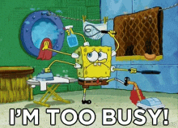
Why is balance so hard these days?
We're always "on"
Busy = Important?
Money stress
Perfection trap
Notes:
Why is balance so hard these days?
You know what's crazy? Our phones make it so we can work all the time. I'll admit - I check work emails in bed sometimes. Bad habit, right?
And there's this weird thing where people think "busy" means "important." With my friends, it's like: "I'm so tired!" "Oh yeah? I'm MORE tired!" We almost brag about being stressed.
Money worries don't help either. Everything costs more now, so people work extra hours just to pay bills. Plus, we try to be perfect at everything - perfect worker, perfect parent - but nobody can do that!
No wonder most people say work-life balance is worse now than 5 years ago. We're always "on," always tired, never stopping. That can't be healthy!

Slide 4
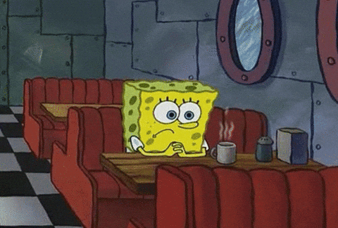
When Work Takes Over Your Life
Coffee is my primary food group now
My pet remembers me... Barely
Typos increase as brain cells decrease
Bucket list becoming a to-do list for retirement
Bonus: My plants survive on neglect - unlike my relationships
Notes:
When work takes over your life, everything suffers. Constant stress makes you sick more often - I’ve had weeks where I worked so much I caught every cold going around. Even when you’re with friends, your mind stays stuck at work - you’re there, but not really present. Relationships suffer most: your partner feels lonely, your kids miss you, friends slowly drift away. And the irony? The more you work, the worse you perform - more tired means more mistakes and fewer good ideas. Worst of all, you stop growing - when will you finally take that dance class, read that book, or just enjoy life? Working non-stop steals what truly matters.

Slide 5
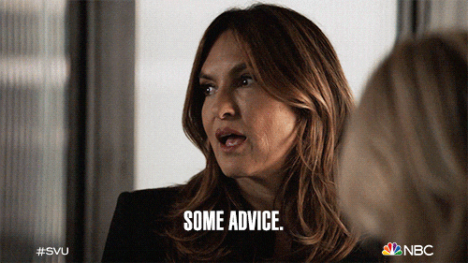
Advices
“Time Lock”
Digital Pauses
Unite Similar
Notes:
When work takes over your life, everything suffers. Constant stress makes you sick more often - I’ve had weeks where I worked so much I caught every cold going around. Even when you’re with friends, your mind stays stuck at work - you’re there, but not really present. Relationships suffer most: your partner feels lonely, your kids miss you, friends slowly drift away. And the irony? The more you work, the worse you perform - more tired means more mistakes and fewer good ideas. Worst of all, you stop growing - when will you finally take that dance class, read that book, or just enjoy life? Working non-stop steals what truly matters.

Slide 6
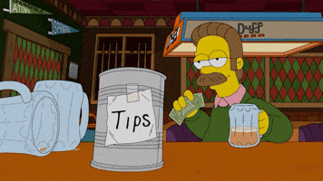
Tips
Delegate Power
Say no
Find time to relax
Notes:
Thank you for your attention! Now I'd love to hear from you - what's the hardest part about balancing work and life for you? Maybe you've found some tricks that help? If you have any questions about what we talked about today, or want me to explain something better, just ask! Sharing our experiences can help us all find better solutions together.

Slide 7

Personal Experience

Slide 8
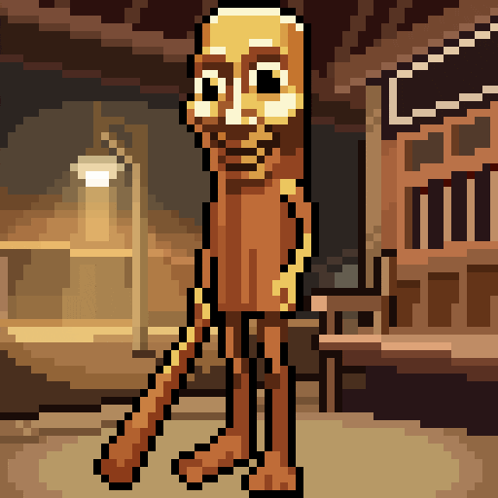
THE END

Slide 9
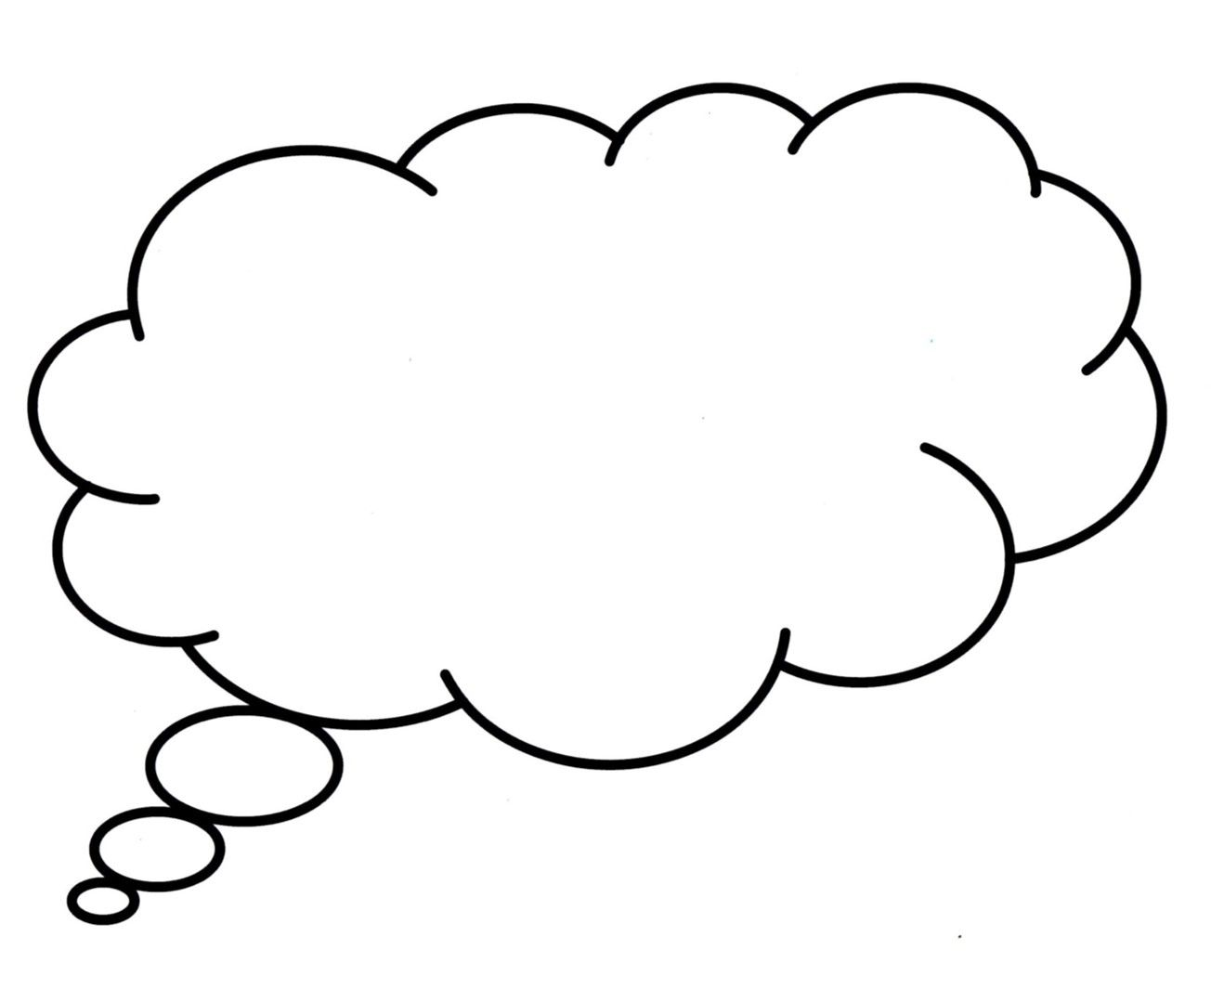
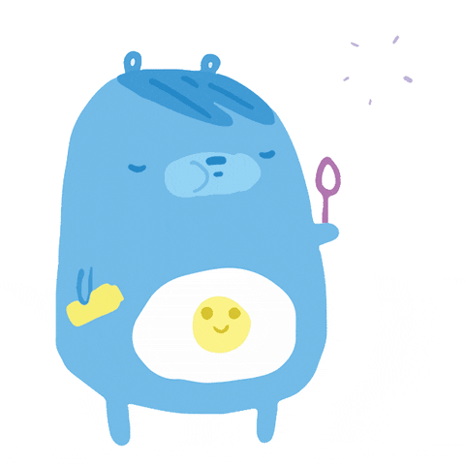
Conversation Bubbles
My biggest struggle is...
One trick that works for me...
Ask me about...
Notes:
Thank you for your attention! Now I'd love to hear from you - what's the hardest part about balancing work and life for you? Maybe you've found some tricks that help? If you have any questions about what we talked about today, or want me to explain something better, just ask! Sharing our experiences can help us all find better solutions together.

